Slide 1
Pm2 install globally
Process-manager—load balancer
Restart server---falty parameter is passed
Terminal log

Slide 2
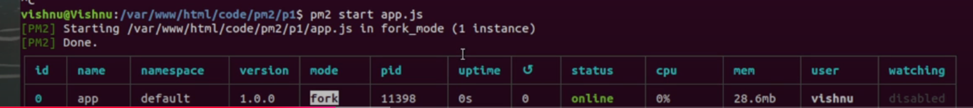

Slide 3
List all pods---pm2 list
Check logs ---pm2 logs <id/name>
Stop –app-pm2 stop <id>
Start-pm2 star <id/name>
Pm2 restart
Pm2 kill
Pm2 kill <id/name>
Change name—pm2 start app.js –name=newname
Pm2 ecosystem ---to generate file

Slide 4
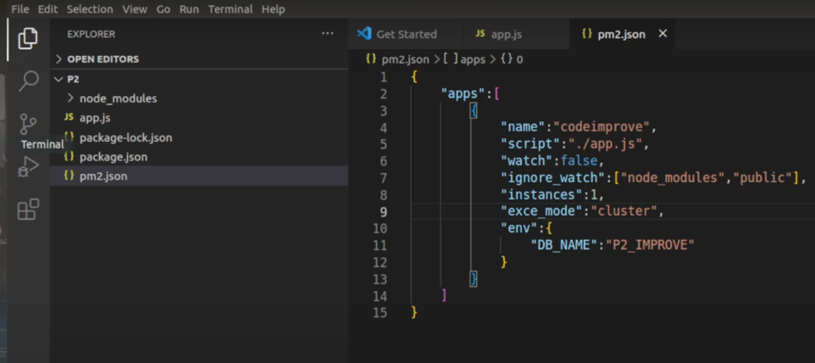
Pm2 start ecosystem.config.js

Slide 5
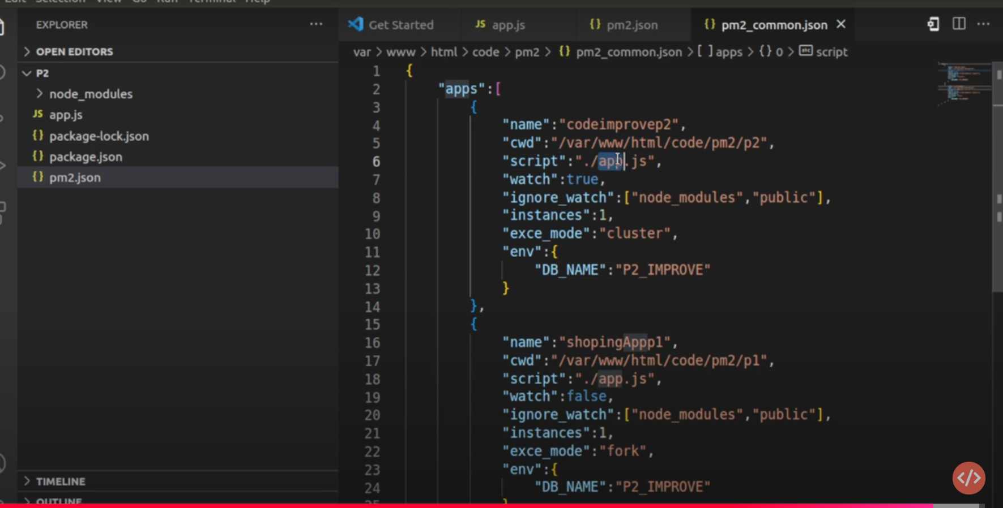
Pm2 start pm2.json

